Slide 1
Defining Non-Traditional Students for Retention Studies
Steven Graunke
Wendy Lin
Norma Fewell
Office of Institutional Research and Decision Support
IUPUI

Slide 2
What we plan to do…
Defining Non-Traditional Students
Retention literature – how have non-traditional students been defined in the past?
How we looked at non-traditional students at IUPUI
Study Results
Implications and discussion

Slide 3

What does “non-traditional” mean to you?
Defining Non-Traditional Students

Slide 4
Defining non-traditional in past retention studies
Defining Non-Traditional Students

Slide 5
Defining non-traditional nationally
Defining Non-Traditional Students
Nationally (Lumina Foundation, 2017)
40% of CC students working 20 or more hours per week
40% attending part-time
38% of undergraduates are 25 years of age or older

Slide 6
Defining non-traditional nationally
Defining Non-Traditional Students
IUPUI Indianapolis – Fall 2018 beginners
14% of students plan to work 20 or more hours per week off campus
4% attending part-time
0.5% (19 out of 3,649) are 25 years of age or older

Slide 7
Defining non-traditional nationally
Defining Non-Traditional Students
IUPUI Indianapolis – Fall 2018 transfers
33% of students plan to work 20 or more hours per week off campus
16% attending part-time
25% are 25 years of age or older

Slide 8

How did we used to think about nontraditional students?
Defining Non-Traditional Students
Summerskill (1962)
“personal or financial or other reasons” cause withdrawal (p.631)
Astin (1975)
Nontraditional = “married, older or attending part-time” (p.167)
Pantagges and Creedon (1978)
Age doesn’t matter when finances, motivation, and other factors are included
Photo courtesy of IUPUI Special Collections Archive

Slide 9

Metzner and Bean studies
(Bean & Metzner, 1985; Metzner & Bean, 1987)
Defining Non-Traditional Students
Student development literature (mostly Chickering, 1969) not appropriate for conceptualizing non-traditional students
One of the following:
25 years or older
Attending part-time
Living off-campus
Findings
Intent to persist, work hours, number of hours enrolled have stronger effect than social integration
“It is very difficult to create an institutional identity and increase a student’s psychological attachment to an institution where traditional social integration variables seem to have little effect on student behavior.” (Bean and Metzner, 1987, p. 34)
Photo courtesy of IUPUI Special Collections Archive

Slide 10
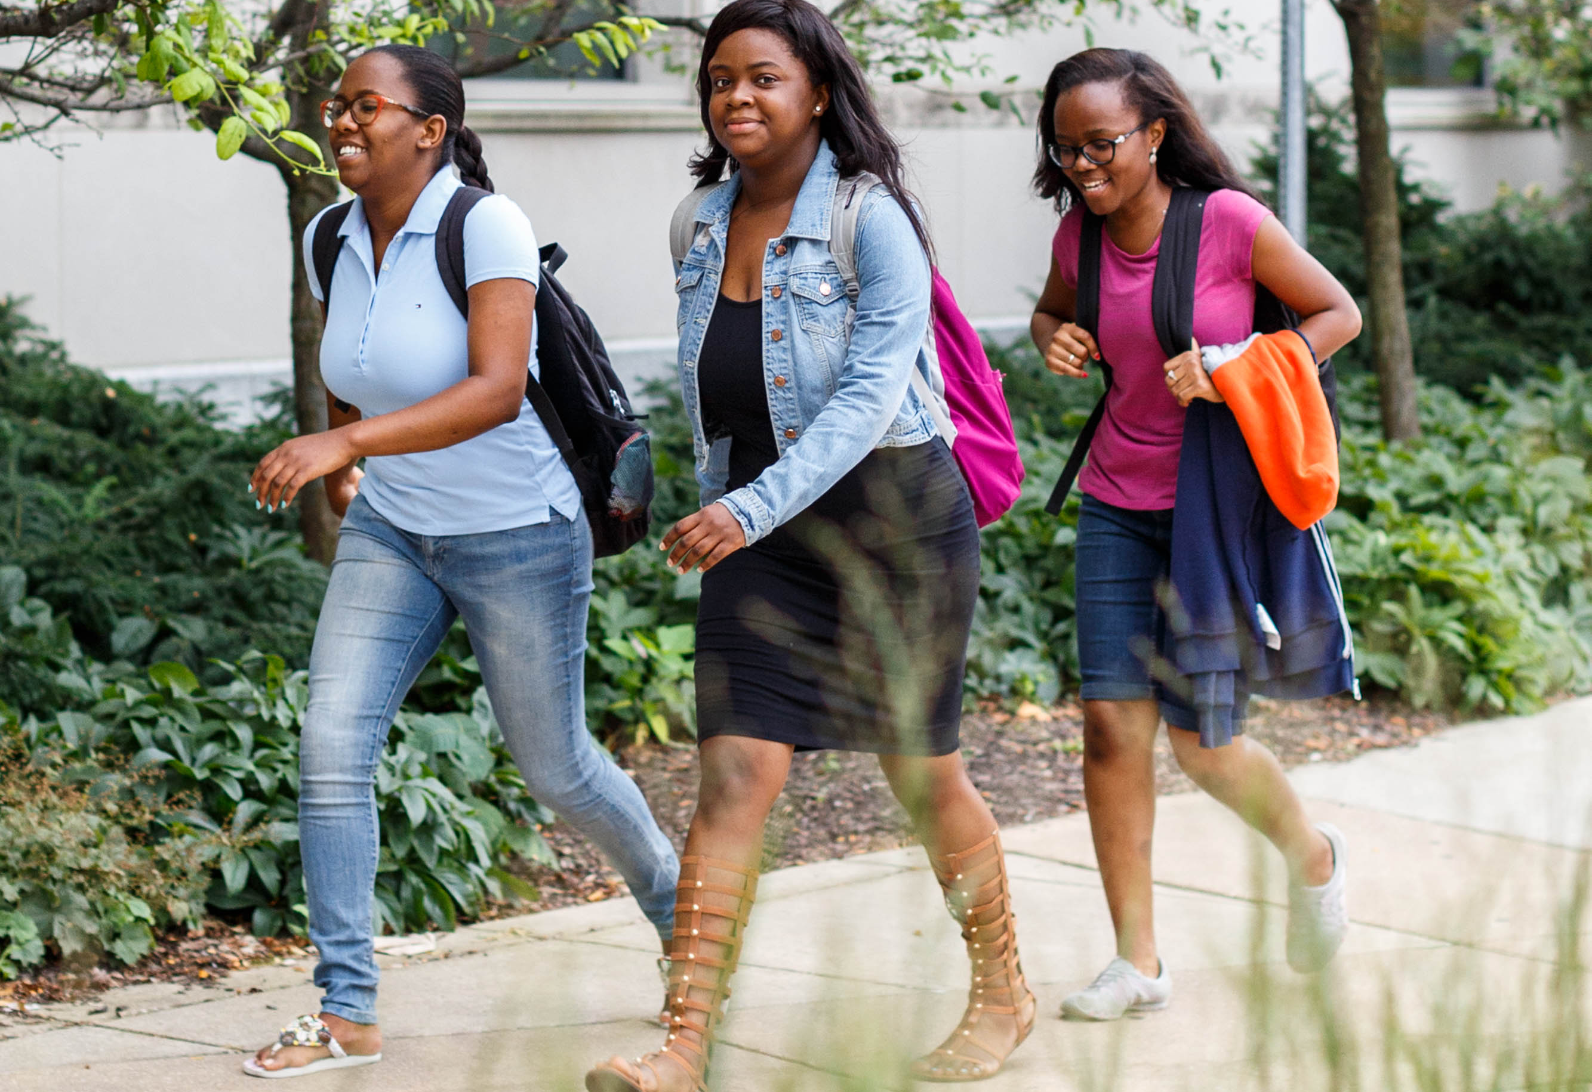
How have we thought about nontraditional students more recently?
Defining Non-Traditional Students
Adelman (2006)
Nontraditional = enrolled in college for the first time after 20.
Arbona and Nora (2007)
Delayed enrollment at least six months
NCES (2017)
Enrollment projections use 24 years of age
Most other retention studies use age (24 and older)
Proxy for other factors (work, family responsibilities, etc.)
This is not the definition NCES uses for retention analyses!

Slide 11
The definition NCES uses for retention
Defining Non-Traditional Students
Horn and Carroll (1996)
“Choices and behavior that may increase students’ risk of attrition” (p. 6)
Intervention is [sometimes] possible
Support to overcome obstacles
Encouragement
One point for each characteristic
Level of Nontraditional
Captures students with “non-traditional “ issues who aren’t “non-traditional” age

Slide 12
The definition NCES uses for retention
Defining Non-Traditional Students
Enrollment patterns
  Delayed enrollment by a year or more
  Attending part-time
Financial and Family Status
  Having a dependent (other than a spouse)
  Being a single parent
  Working full-time
  Being financially independent
High School Graduation Status
  Earning a GED rather than a high school diploma

Slide 13
How is IUPUI defining non-traditional?
Defining Non-Traditional Students
Use national literature to define nontraditional
NCES characteristics are age-neutral
Currently tracking both 23 and 25
Which is better?
National would be 25 or older

Slide 14
Our Research Questions…
Defining Non-Traditional Students
Does score on the Horn and Carroll scale have a significant effect on retention net the effect of age and other academic and financial variables?
Could enhanced understanding of the Horn and Carroll model lead to an expanded understanding of the challenges faced by nontraditional students as they complete their degree at IUPUI?

Slide 15
Methodology
Defining Non-Traditional Students

Slide 16
Methodology
Defining Non-Traditional Students
Survey of incoming first-year and transfer students in Fall 2015
“How many hours per week” – working on campus, working off campus.
Merged with IUPUI data
Enrollment status (full-time or part-time)
FAFSA data
Earned a GED
Construct Horn & Carrol scale!

Slide 17
Methodology
Defining Non-Traditional Students
Additional data
High school GPA
First generation
Transfer hours
Unmet financial need (CDS definition)
Received Pell grant
Age

Slide 18
Analysis
Defining Non-Traditional Students
Descriptive statistics
Correlation
Logistic regression

Slide 19
Descriptive statistics
(Non-traditional Characteristics) *
Defining Non-Traditional Students
Characteristic | Total | N | Percentage
Attending part-time | 4,845 | 422 | 8.7%
GED | 4,845 | 1 | <0.1%
Not claimed as a dependent | 4,268 | 531 | 12.4%
Has a child | 4,279 | 180 | 4.2%
Single parent | 4,279 | 89 | 2.1%
Working full-time ** | 338 | 24 | 7.1%
* Full sample, including traditional and non-traditional students. Average age = 19.7, std. dev = 4.0
** Obtained from Student-Institution fit survey. All other data from University records

Slide 20
Correlation with age
Defining Non-Traditional Students
Characteristic | Total | N | r
Attending part-time | 4,845 | 422 | 0.29
GED | 4,845 | 1 | 0.08
Not claimed as a dependent | 4,268 | 531 | 0.69
Has a child | 4,279 | 180 | 0.50
Single parent | 4,279 | 89 | 0.20
Working full-time | 338 | 24 | 0.32
All correlations statistically significant at α < 0.01

Slide 21
Descriptive statistics (Race/Ethnicity)
Defining Non-Traditional Students
Race/Ethnicity | Percent of Minimally Nontraditional* | Percent of Traditional
Native American/Alaska Native | 0.2% | 0.1%
Asian | 3.2% | 3.7%
African American | 18.2% | 8.7%
Latino/a | 6.7% | 8.2%
International | 1.2% | 0.6%
Native Hawaiian/Pacific Islander | 0.6% | 0.1%
Two or More Races | 5.8% | 5.5%
White | 63.5% | 72.8%
Unknown | 0.7% | 0.3%
* At least one nontraditional characteristic (Attending part-time, GED, Not claimed as a dependent, Has a child, Single parent). Working full-time excluded due to low response rate.

Slide 22
Descriptive statistics (Other Characteristics)
Defining Non-Traditional Students
Characteristic | Percent of Minimally Nontraditional * | Percent of Traditional
Female | 54.0% | 60.2%
Transfer | 70.2% | 14.6%
First Generation | 40.8% | 34.6%
Receiving a Pell Grant | 64.5% | 42.6%
* At least one nontraditional characteristic (Attending part-time, GED, Not claimed as a dependent, Has a child, Single parent). Working full-time excluded due to low response rate.
All differences statistically significant at α < 0.01.

Slide 23
Descriptive statistics (Other Characteristics)
Defining Non-Traditional Students
Characteristic | Mean among Minimally Nontraditional * | Mean among Traditional
High School GPA**^ | 3.09 | 3.40
Transfer GPA*** | 2.97 | 2.96
Unmet Financial Need^ | $8,328 | $4,028
* At least one nontraditional characteristic (Attending part-time, GED, Not claimed as a dependent, Has a child, Single parent). Working full-time excluded due to low response rate.
** Among students who entered IUPUI as first-time beginners.
***Among students who entered IUPUI as internal or external transfer students
^ Differences statistically significant at α < 0.01

Slide 24
Logistic Regression: Fall-Fall Retention
Defining Non-Traditional Students
Z transformation of high school GPA and transfer GPA
Same scale
“How much higher was past performance than a person of the same admit type?”
Ethnicity
Exclude null and International
Reference group = White
First Generation (1,0)
Unmet need (divided by $1,000)
Easier to interpret results
Received a Pell grant (1,0)

Slide 25

Logistic Regression: Fall-Fall Retention
Defining Non-Traditional Students
Age: 2 models
23 or older =1
25 or older = 1
[Modified] Horn & Carroll scale
No work = More cases
Interaction between Nontraditional scale and age

Slide 26
Fall-Fall Retention 25 or older
Defining Non-Traditional Students
Variable | B | Standard Error | Odds Ratio
Intercept | 1.63 | 0.23
Ethnicity
Native American/Alaska Native | -0.15 | 1.06 | 1.29
Asian | 0.48 | 0.30 | 2.43
African American* | -0.50 | 0.24 | 0.91
Latino/a | -0.16 | 0.25 | 1.29
International | 0.36 | 0.82 | 2.15
Native Hawaiian/Pacific Islander | 0.32 | 0.98 | 2.07
Two or More Races* | -0.56 | 0.26 | 0.86
Unknown | 0.62 | 0.64 | 2.79
Z-score of pre-entry GPA* | 0.60 | 0.04 | 1.82
First Generation* | -0.20 | 0.08 | 0.82
Unmet Need/$1,000* | -0.09 | 0.01 | 0.92
Received a Pell grant | 0.09 | 0.08 | 1.09
Age 25 or older* | 0.33 | 0.15 | 1.40
* Effect is statistically significant net the effect of other variables at α < 0.05

Slide 27
Fall-Fall Retention 23 or older
Defining Non-Traditional Students
Variable | B | Standard Error | Odds Ratio
Intercept | 1.62 | 0.23
Ethnicity
Native American/Alaska Native | -0.12 | 1.06 | 1.32
Asian | 0.49 | 0.30 | 2.43
African American* | -0.50 | 0.24 | 0.90
Latino/a | -0.14 | 0.25 | 1.30
International | 0.33 | 0.81 | 2.07
Native Hawaiian/Pacific Islander | 0.30 | 1.00 | 2.00
Two or More Races* | -0.55 | 0.26 | 0.86
Unknown | 0.59 | 0.64 | 2.70
Z-score of pre-entry GPA* | 0.60 | 0.04 | 1.82
First Generation* | -0.20 | 0.08 | 0.82
Unmet Need/$1,000* | -0.09 | 0.01 | 0.92
Received a Pell grant | 0.08 | 0.08 | 1.08
Age 23 or older* | 0.47 | 0.13 | 1.60
* Effect is statistically significant net the effect of other variables at α < 0.05

Slide 28
Fall-Fall Retention 25 or older – Include Nontraditional Scale
Defining Non-Traditional Students
Variable | B | Standard Error | Odds Ratio
Intercept | 1.65 | 0.23
Native American/Alaska Native | -0.18 | 1.06 | 1.29
Asian | 0.46 | 0.30 | 2.45
African American* | -0.52 | 0.24 | 0.92
Latino/a | -0.19 | 0.25 | 1.29
International | 0.32 | 0.82 | 2.15
Native Hawaiian/Pacific Islander | 0.49 | 0.99 | 2.54
Two or More Races* | -0.57 | 0.26 | 0.88
Unknown | 0.62 | 0.63 | 2.88
Z-score of pre-entry GPA* | 0.60 | 0.04 | 1.82
First Generation* | -0.21 | 0.08 | 0.81
Unmet Need/$1,000* | -0.09 | 0.01 | 0.92
Received a Pell grant | 0.09 | 0.08 | 1.10
Age 25 or older* | 1.04 | 0.33
Nontraditional scale | -0.02 | 0.08
Age 25*Nontraditional* | -0.35 | 0.17
* Effect is statistically significant net the effect of other variables at α < 0.05

Slide 29
Fall-Fall Retention 23 or older – Include Nontraditional Scale
Defining Non-Traditional Students
Variable | B | Standard Error | Odds Ratio
Intercept | 1.62 | 0.23
Native American/Alaska Native | -0.15 | 1.06 | 1.30
Asian | 0.47 | 0.30 | 2.42
African American* | -0.49 | 0.24 | 0.92
Latino/a | -0.14 | 0.25 | 1.30
International | 0.25 | 0.80 | 1.92
Native Hawaiian/Pacific Islander | 0.43 | 1.00 | 2.32
Two or More Races* | -0.55 | 0.26 | 0.87
Unknown | 0.58 | 0.64 | 2.70
Z-score of pre-entry GPA* | 0.60 | 0.04 | 1.83
First Generation* | -0.20 | 0.08 | 0.82
Unmet Need/$1,000* | -0.09 | 0.01 | 0.92
Received a Pell grant | 0.09 | 0.08 | 1.10
Age 23 or older* | 0.87 | 0.24
Nontraditional scale* | -0.20 | 0.10
Age 23*Nontraditional | -0.05 | 0.15
* Effect is statistically significant net the effect of other variables at α < 0.05

Slide 30

Discussion
Defining Non-Traditional Students
We need better data on off-campus work
Intersectionality with a lot of factors that effect retention
Age has an effect regardless of cut off
Effect of nontraditional differs with different cut off
More research is needed

Slide 31
Implications
Defining Non-Traditional Students
Age is positive when accounting for other factors
  Previous academic success, unmet need, first gen matter a lot
  Maturity? Other factors?
More nontraditional commitments has an impact, but how?
  IUPUI is becoming younger.
  Getting more students to work on campus
Programming should use an expanded definition of “nontraditional”
  Degree Completion Office
What is the right cut off?

Slide 32

Defining Non-Traditional Students
Any Questions?
Comments?

